Slide 1


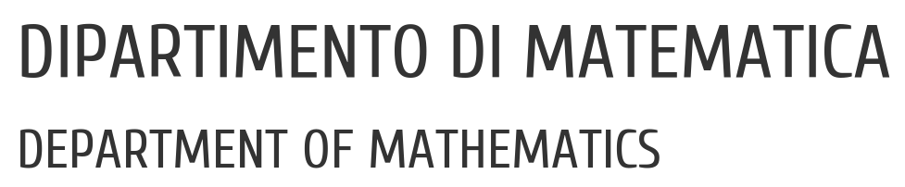

UNIVERSITY OF PADUA
UNIVERSITA’ DEGLI STUDI DI PADOVA
Instance Segmentation of Urban Street Scenes
Francesco Bari, Eleonora Signor
Vision and Cognitive Systems - Prof. Lamberto Ballan
21 February 2022

Slide 2

UNIVERSITY OF PADUA
UNIVERSITA’ DEGLI STUDI DI PADOVA
Vision and Cognitive Systems
Table of contents
HOW ?
Introduction
Related works
Datasets
Method
Experiments
Conclusion
WHY ?
WHAT ?

Slide 3
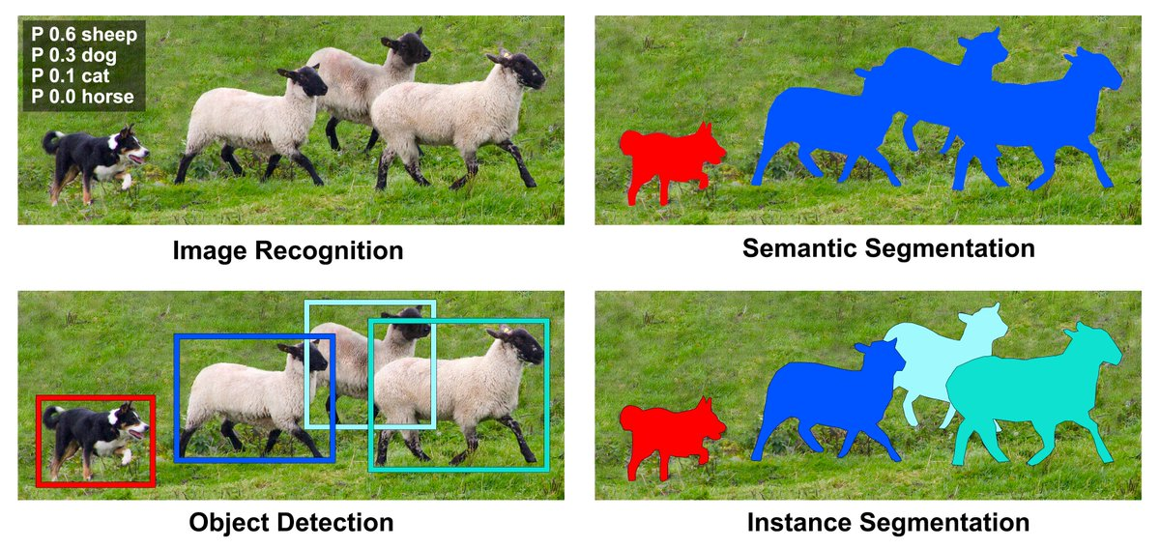
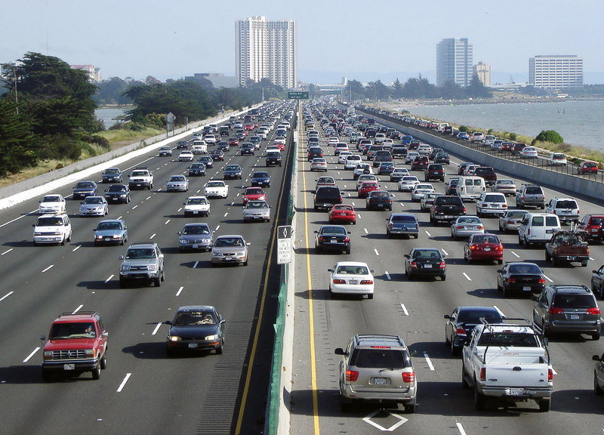
UNIVERSITY OF PADUA
UNIVERSITA’ DEGLI STUDI DI PADOVA
Vision and Cognitive Systems
Goal:
Instance Segmentation of Urban Street Scenes

Slide 4
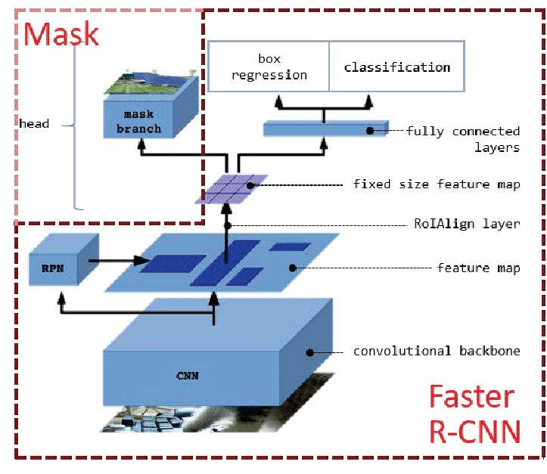
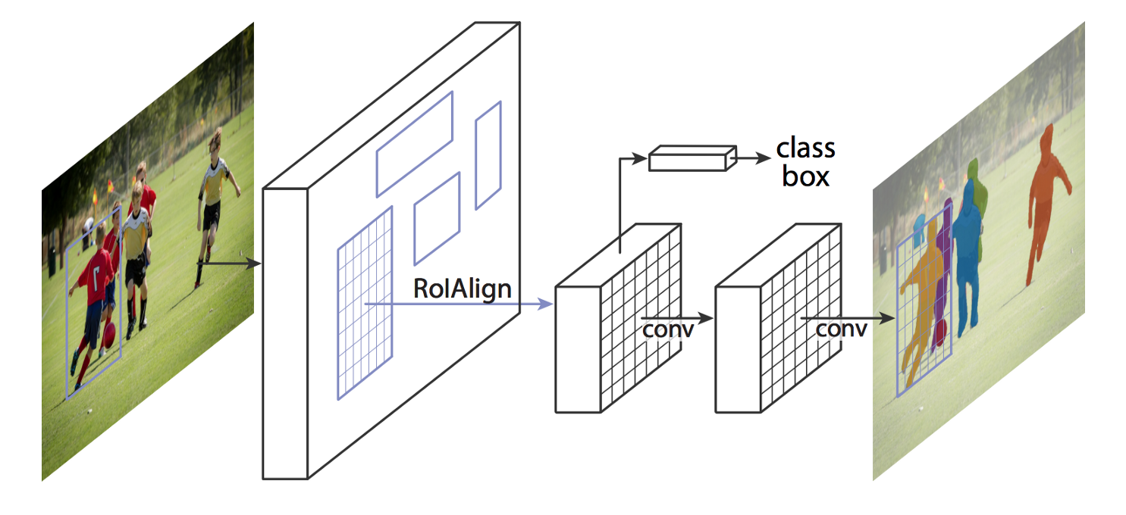

UNIVERSITY OF PADUA
UNIVERSITA’ DEGLI STUDI DI PADOVA
Vision and Cognitive Systems
Mask R-CNN: Box-based two stage approch
- Generates a segmentation mask for each instance
- Region Proposal Network
- Class label, bounding box offset and object mask
- Backbone and head
- RoIAlign
COMPLICATED SCENARIOS
MULTI-TASK NETWORK

Slide 5
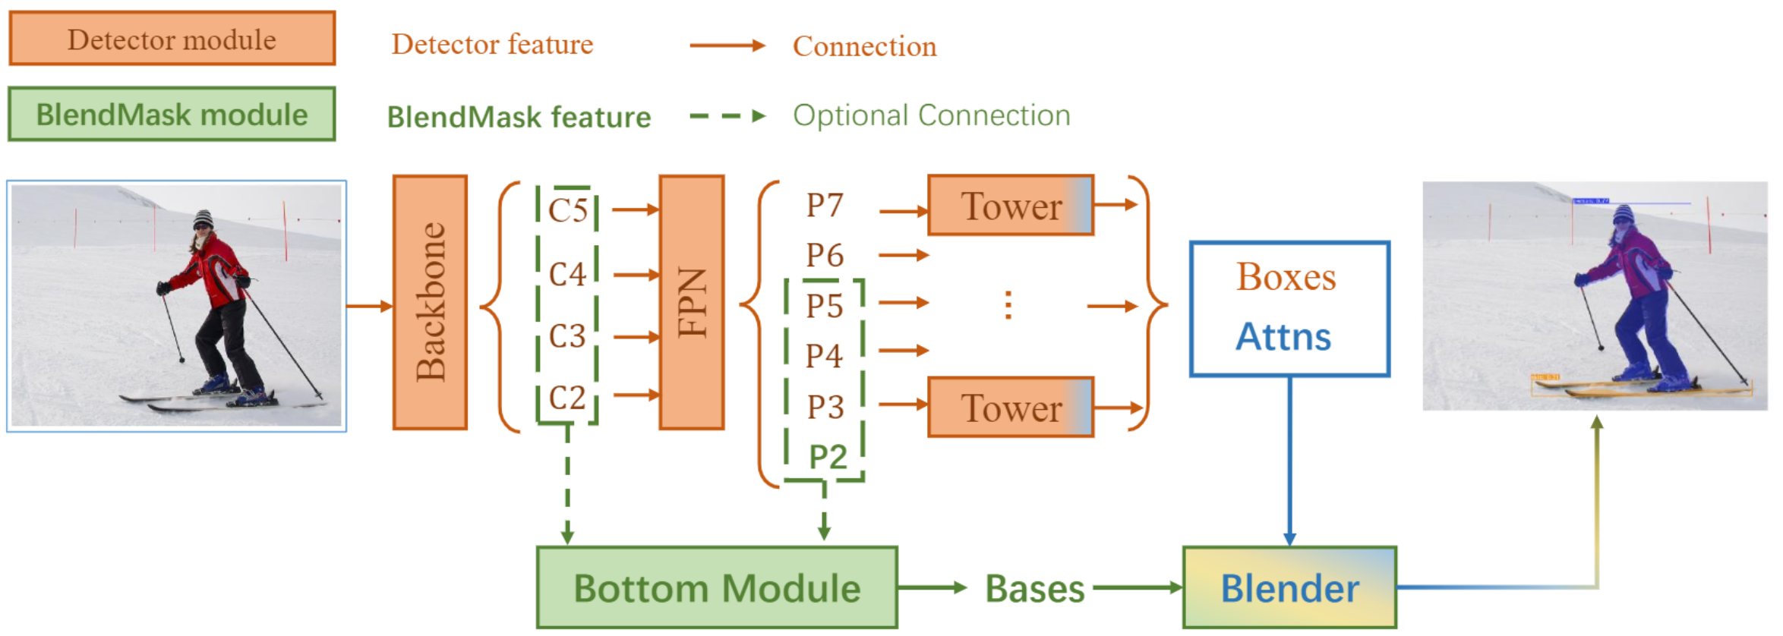
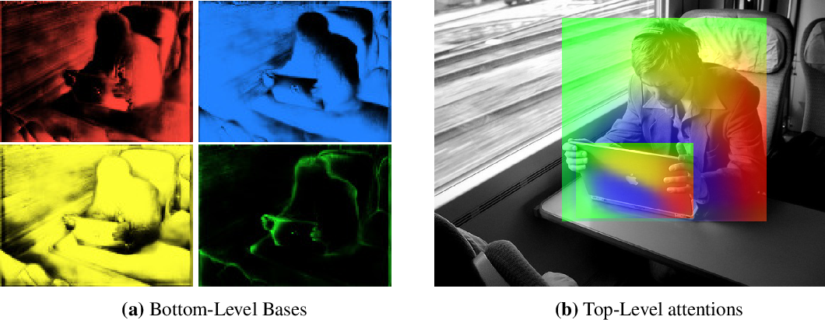

UNIVERSITY OF PADUA
UNIVERSITA’ DEGLI STUDI DI PADOVA
Vision and Cognitive Systems
BlendMask: Anchor box-free one-stage approach
- Bottom module: deals with the production of the bases
- Top layer: a single convolution layer, one for each tower. Predictions attention instances
- Blender module: combines bases with attentions
BETTER IN TIME AND PRECISION

Slide 6
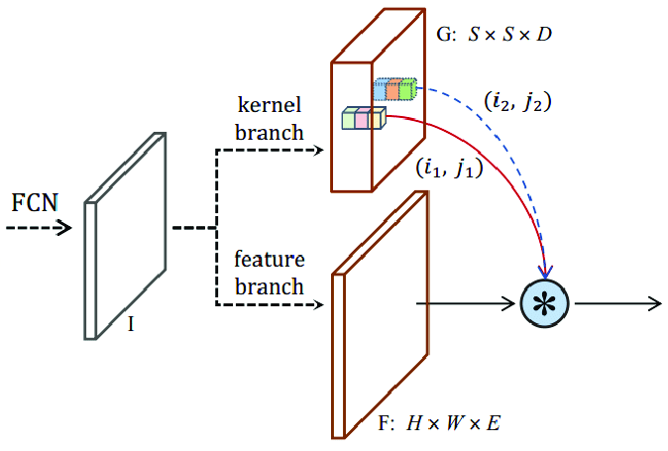
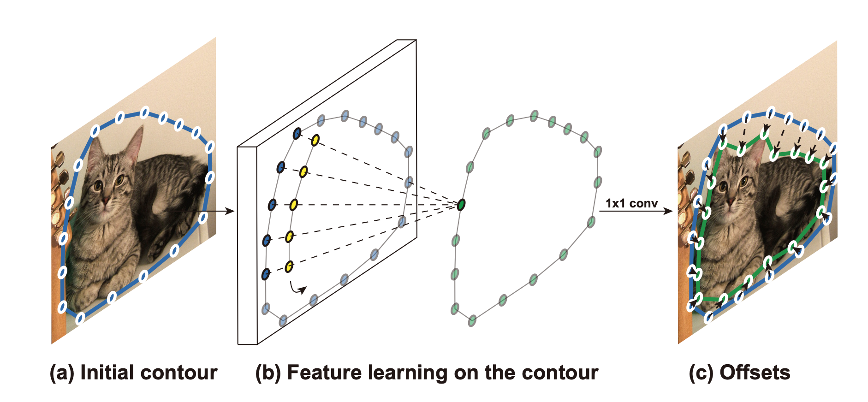
UNIVERSITY OF PADUA
UNIVERSITA’ DEGLI STUDI DI PADOVA
Vision and Cognitive Systems
SOLOv2
DEEP SNAKE
Box-free one-stage approach
Contour-based approach
- Mask kernel prediction and mask feature learning
- Matrix non-maximum suppression (NMS)
- Initial contour proposal iteratively deforms
- Circular Convolution

Slide 7
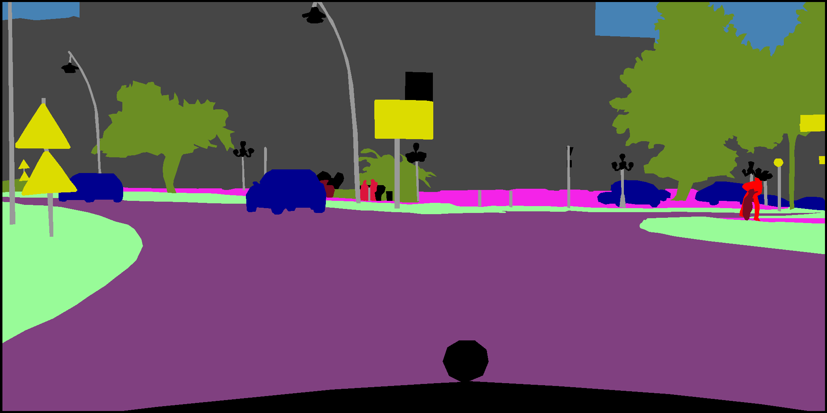
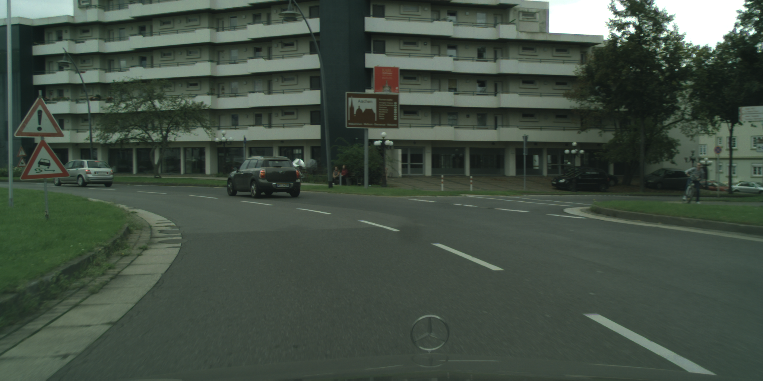
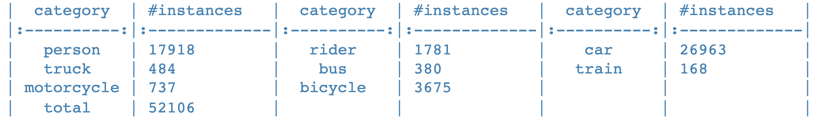

UNIVERSITY OF PADUA
UNIVERSITA’ DEGLI STUDI DI PADOVA
Vision and Cognitive Systems
Cityscapes
- Benchmarks and large-scale datasets for semantic urban scene understanding
- Video sequences, recorded in 50 different cities
- High-quality annotations or/and coarse annotation
- gtFine & leftImg8
3475 train/val images
1525 test images
5000 total images
8 classes
PROBLEM : always images in good weather conditions

Slide 8
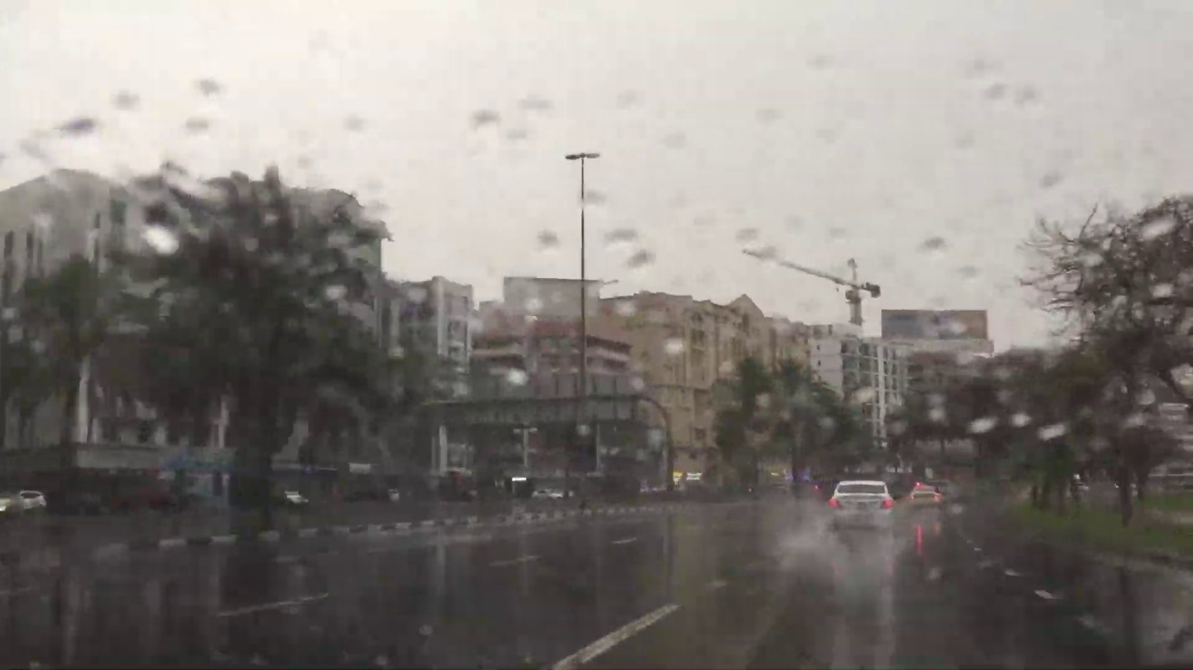

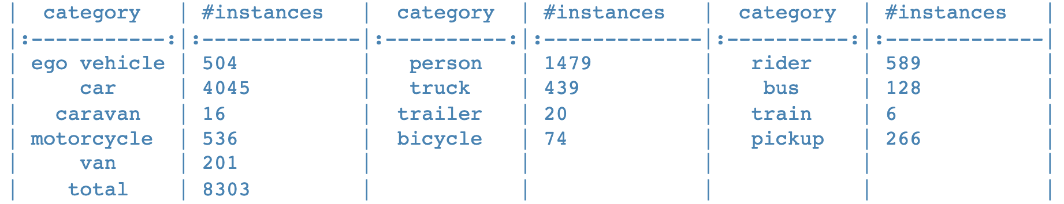

UNIVERSITY OF PADUA
UNIVERSITA’ DEGLI STUDI DI PADOVA
Vision and Cognitive Systems
WildDash
- Benchmark suite and dataset for semantic and instance segmentation for the automotive domain
- Scenarios such as rain, darkness and road cover
- public gt package
3405 train images
851 test images
4256 total images
13 classes
CHALLENGES

Slide 9



UNIVERSITY OF PADUA
UNIVERSITA’ DEGLI STUDI DI PADOVA
Vision and Cognitive Systems
Method
- Detectron2
- AdelaiDet
- Ideal models found during the experiments
- Metrics for concretise the concept of comparison

Slide 10
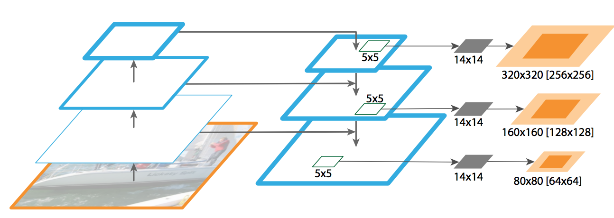
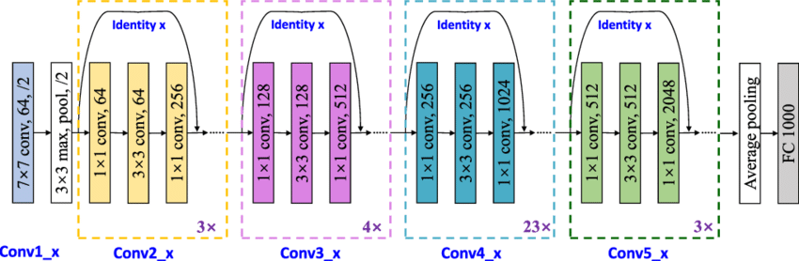
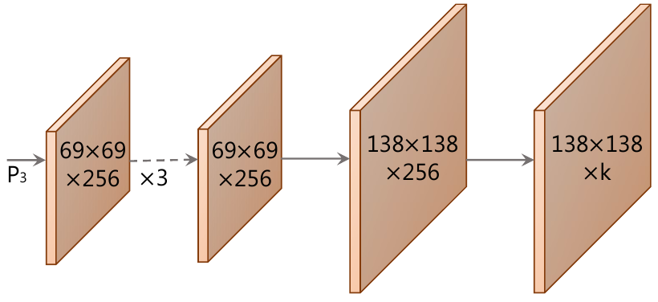
UNIVERSITY OF PADUA
UNIVERSITA’ DEGLI STUDI DI PADOVA
Vision and Cognitive Systems
Architecture
- We decided to use ResNet-101-FPN as a backbone
- In addition, as the bottom module of BlendMask, we have instantiated ProtoNet

Slide 11

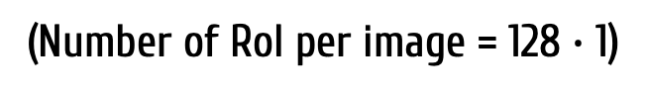
UNIVERSITY OF PADUA
UNIVERSITA’ DEGLI STUDI DI PADOVA
Vision and Cognitive Systems
Hyperparameters
We tried to keep the same parameters defined in the papers (Mask R-CNN & BlendMask)
We modified those that did not allow us to run on Colab:
Number of iterations: 4.000 for Mask R-CNN (default 40.000)
Number of iterations: 2.000 for BlendMask (default 40.000)
Batch size per image: 128 (default 512)
Images per batch across all machines: 1 (we use only 1 GPU)
(Number of RoI per image = 128 $∙$ 1)

Slide 12
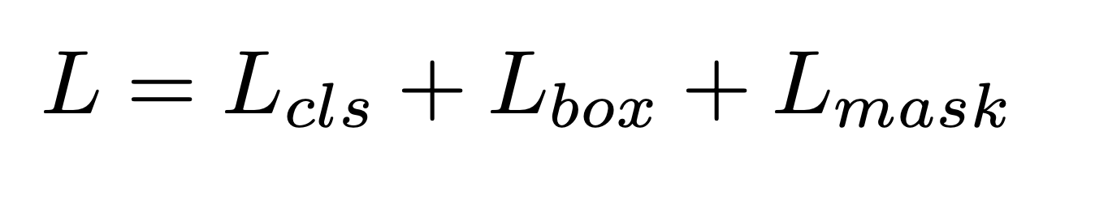
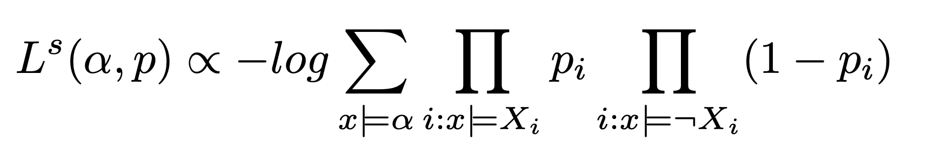
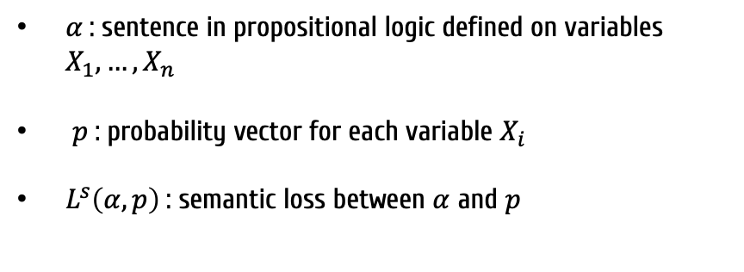
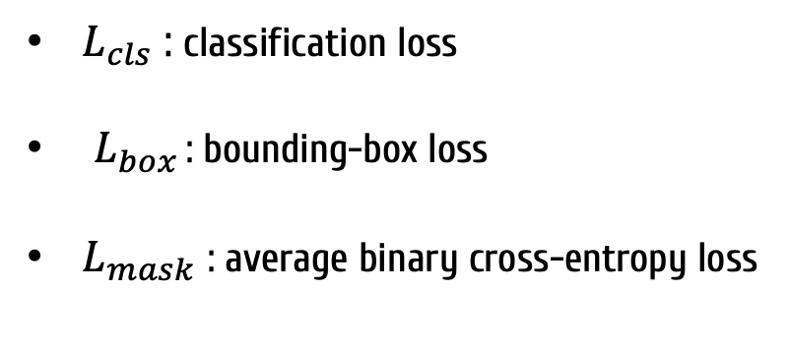
UNIVERSITY OF PADUA
UNIVERSITA’ DEGLI STUDI DI PADOVA
Vision and Cognitive Systems
Loss functions
Mask R-CNN
BlendMask
Simulate the same Loss
(Multi-task loss on each RoI)
(optional – no big difference)
$L_{cls}$ : classification loss
$L_{box }$: bounding-box loss
$L_{mask}$ : average binary cross-entropy loss
$α$: sentence in propositional logic defined on variables $X_{1},…, X_{n}$
$p$: probability vector for each variable $X_{i}$
$L^{s}\left(α,p\right)$: semantic loss between $α$ and $p$

Slide 13

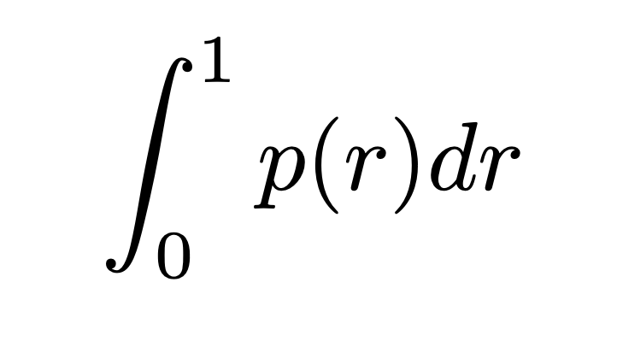
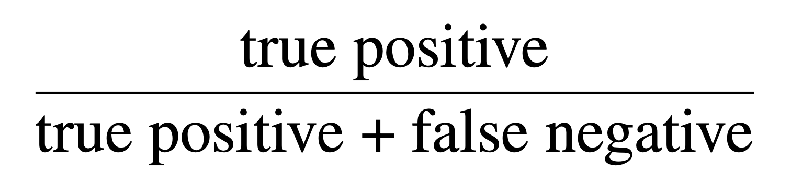

UNIVERSITY OF PADUA
UNIVERSITA’ DEGLI STUDI DI PADOVA
Vision and Cognitive Systems
Evaluation
We use Average Precision (AP):
$p\left(r\right)$: the area under the curve of maximum intersection between:
- Recall
- Precision
10 IoU thresholds from the range .50:.05:.95
AP is averaged over Intersection over Union (IoU) values (standard COCO metrics)
For each metric are extracted the 100 detections with the highest score (1000 proposal)

Slide 14

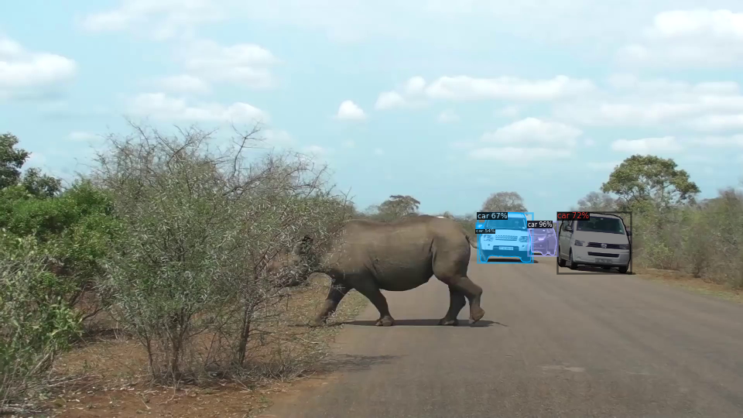
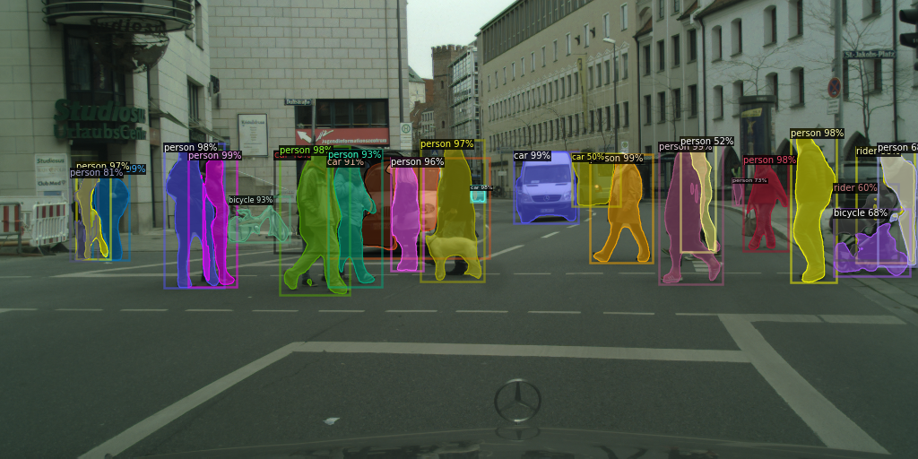
UNIVERSITY OF PADUA
UNIVERSITA’ DEGLI STUDI DI PADOVA
Vision and Cognitive Systems
Experiments
Define ’’Ideal Models’’ via experiments:
Backbones
Frozen Layer
(Parameters to run on Colab and Semantic loss)

Slide 15

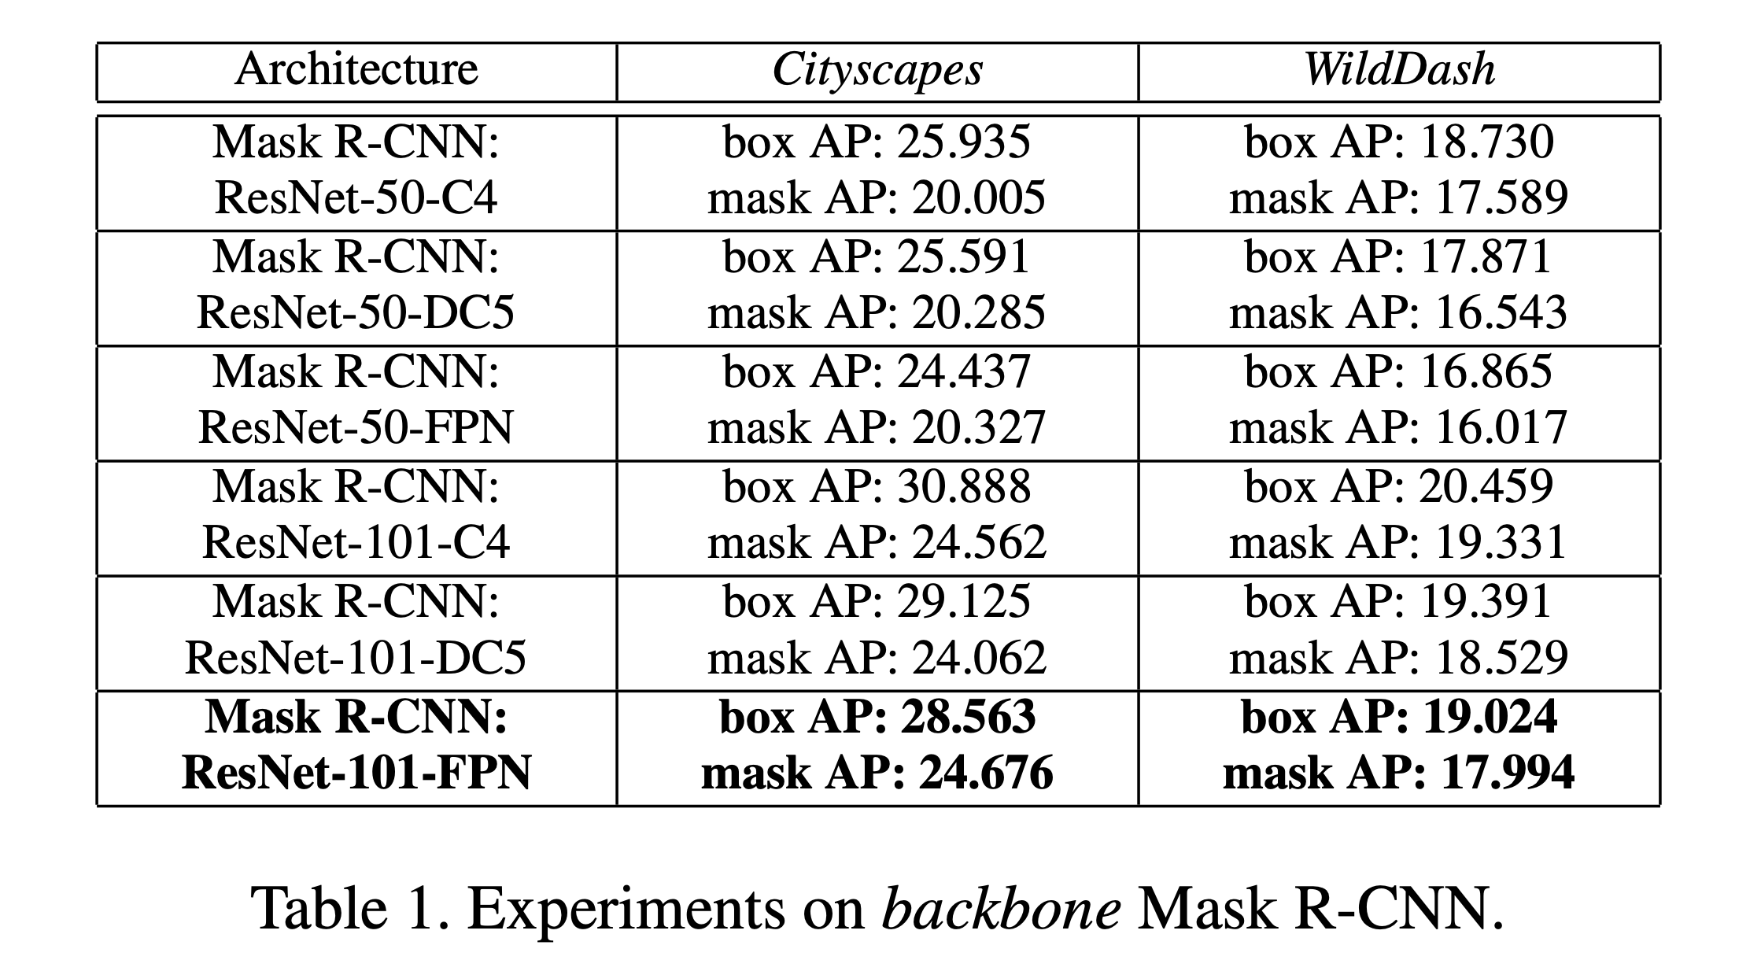
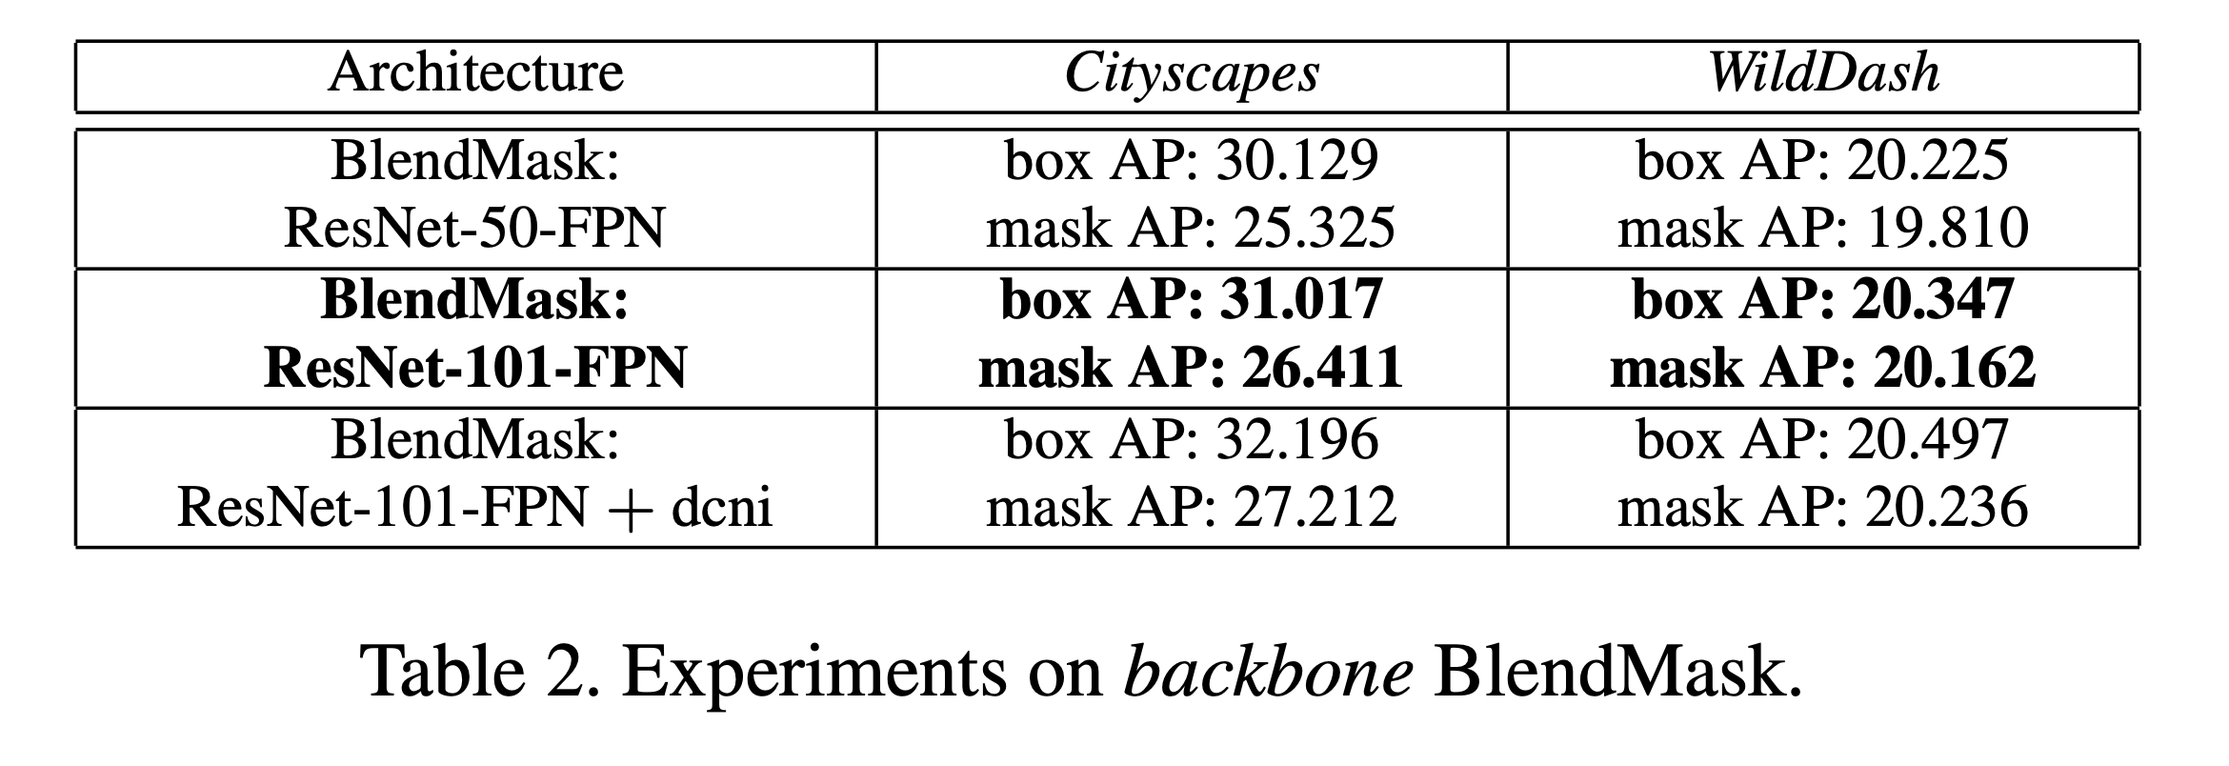
UNIVERSITY OF PADUA
UNIVERSITA’ DEGLI STUDI DI PADOVA
Vision and Cognitive Systems
Backbones
ResNet-101-FPN

Slide 16

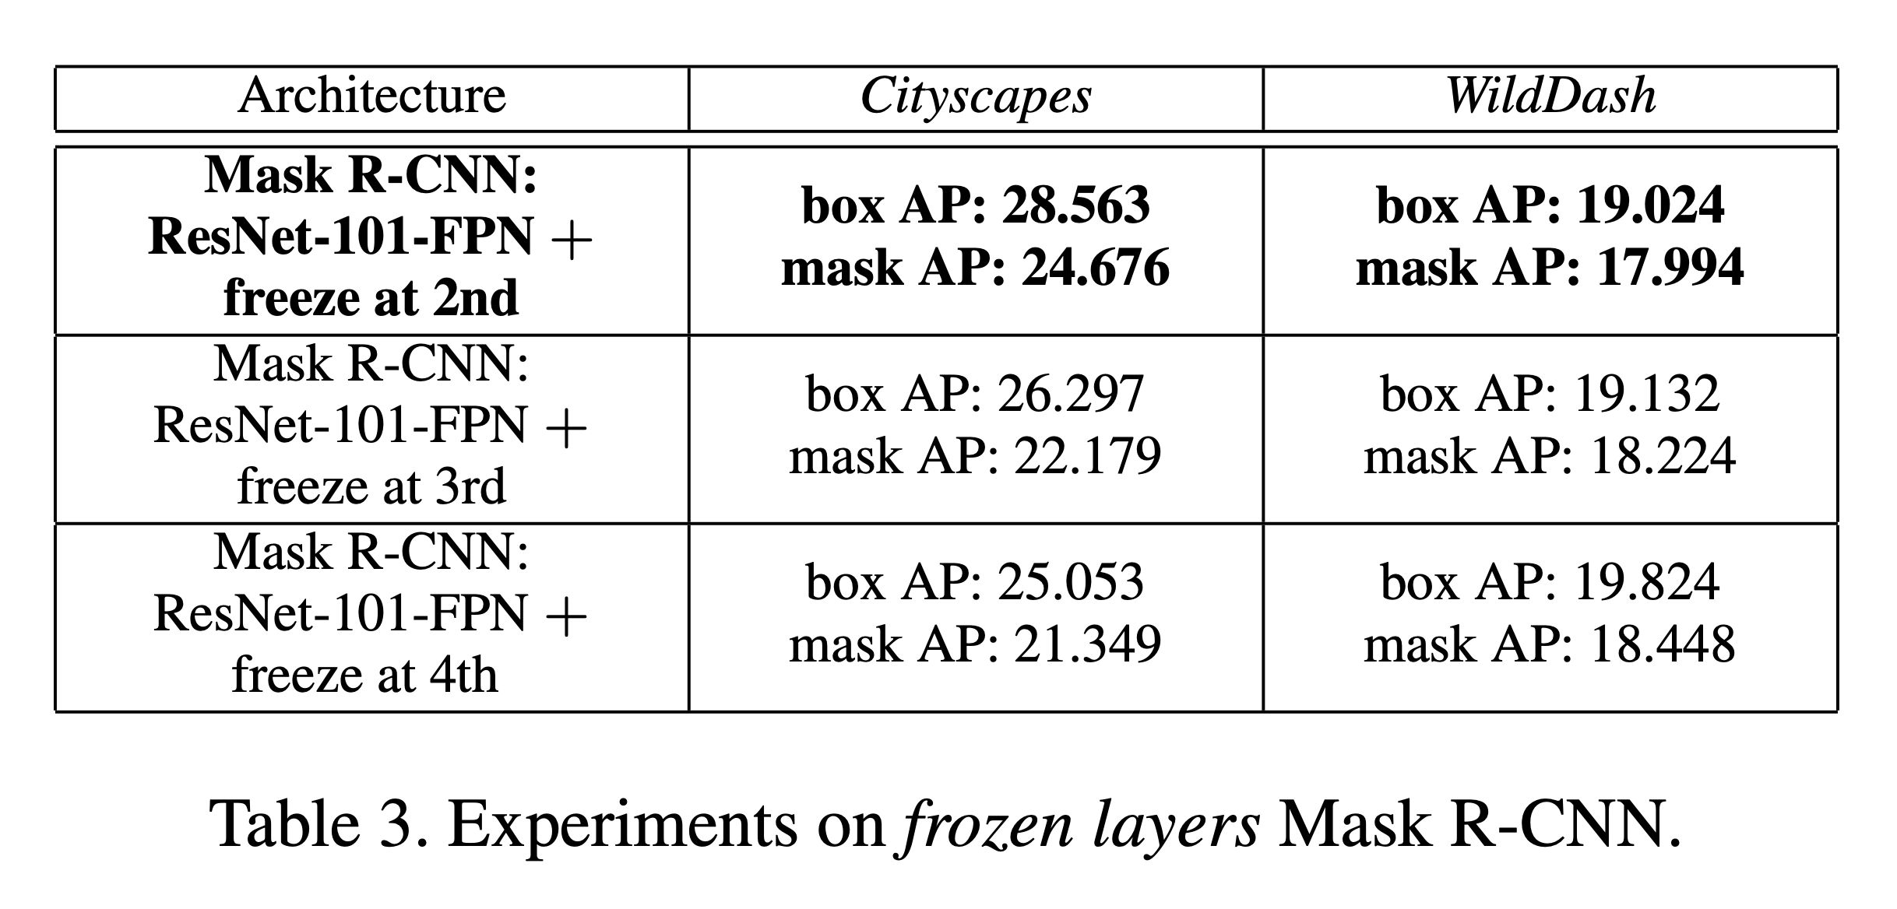
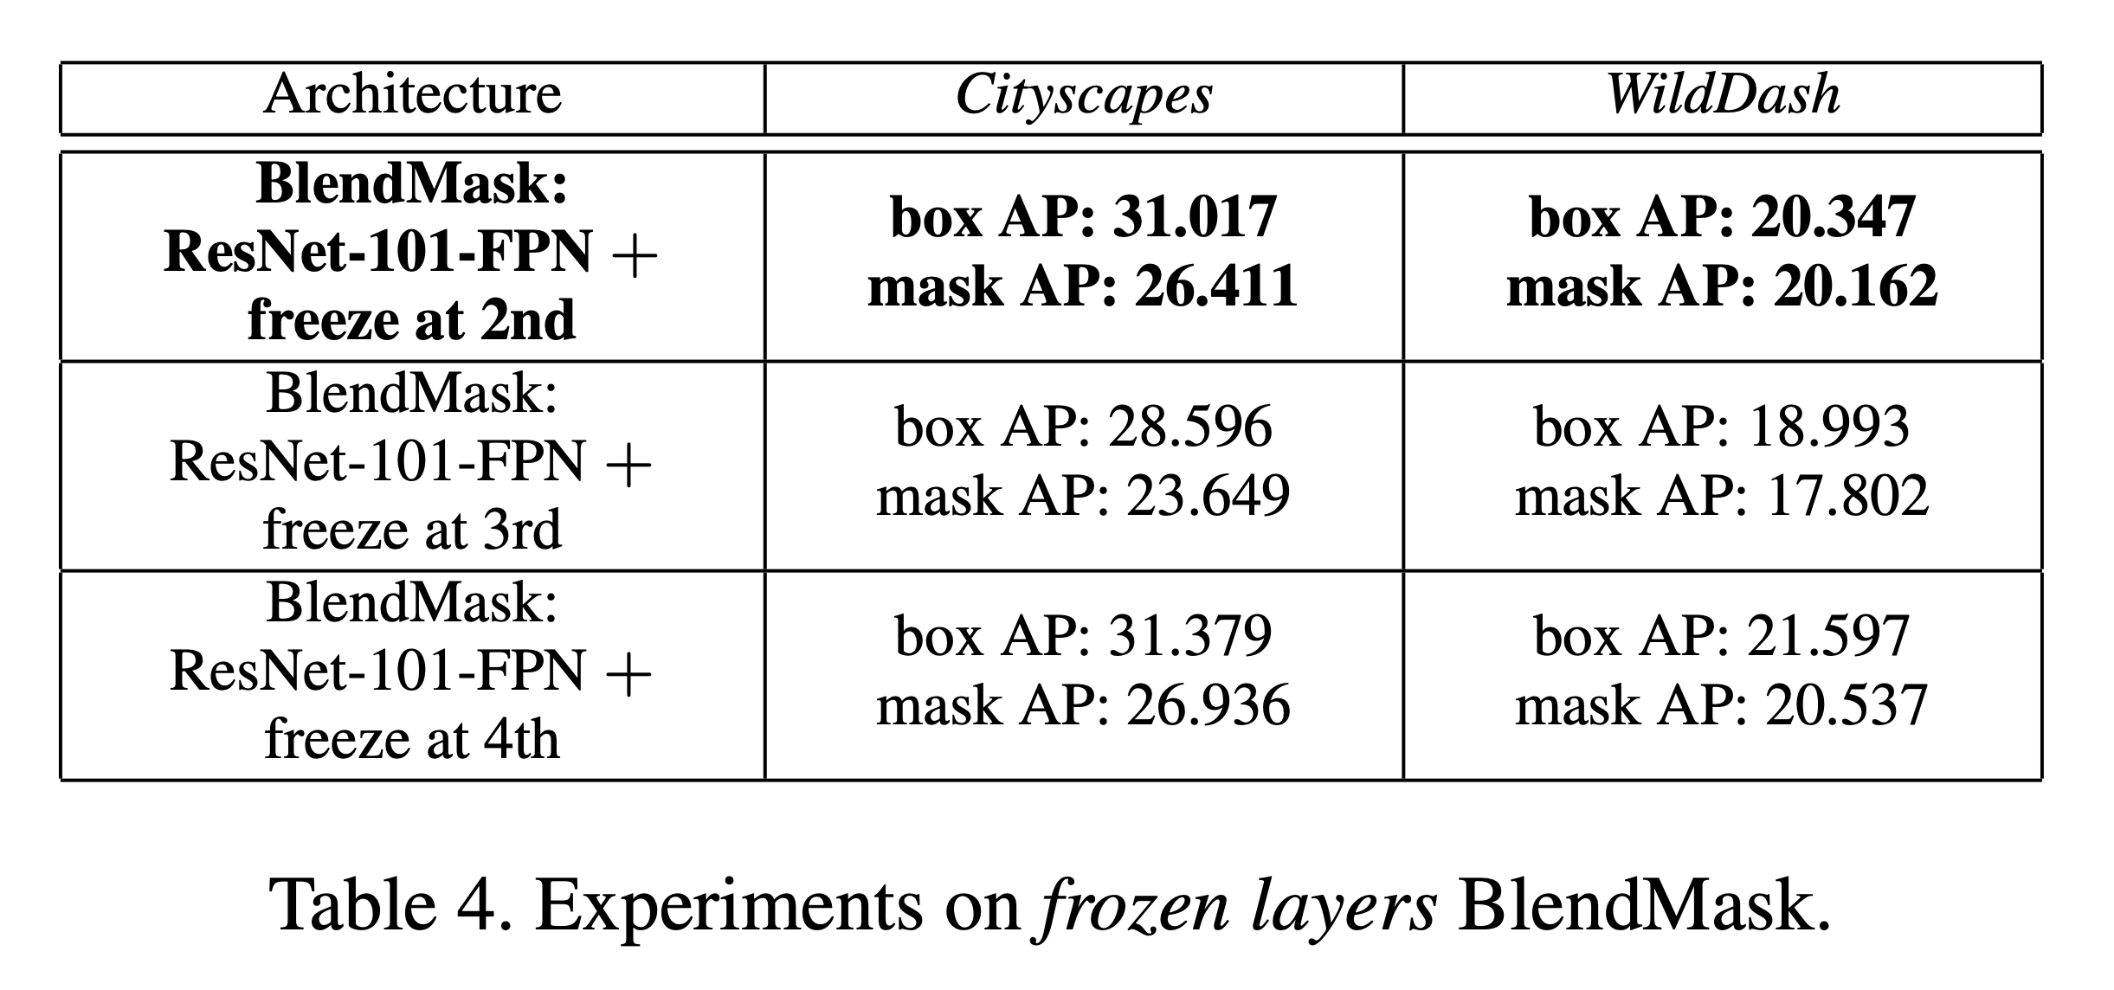
UNIVERSITY OF PADUA
UNIVERSITA’ DEGLI STUDI DI PADOVA
Vision and Cognitive Systems
Frozen Layers
Freeze at 2nd

Slide 17

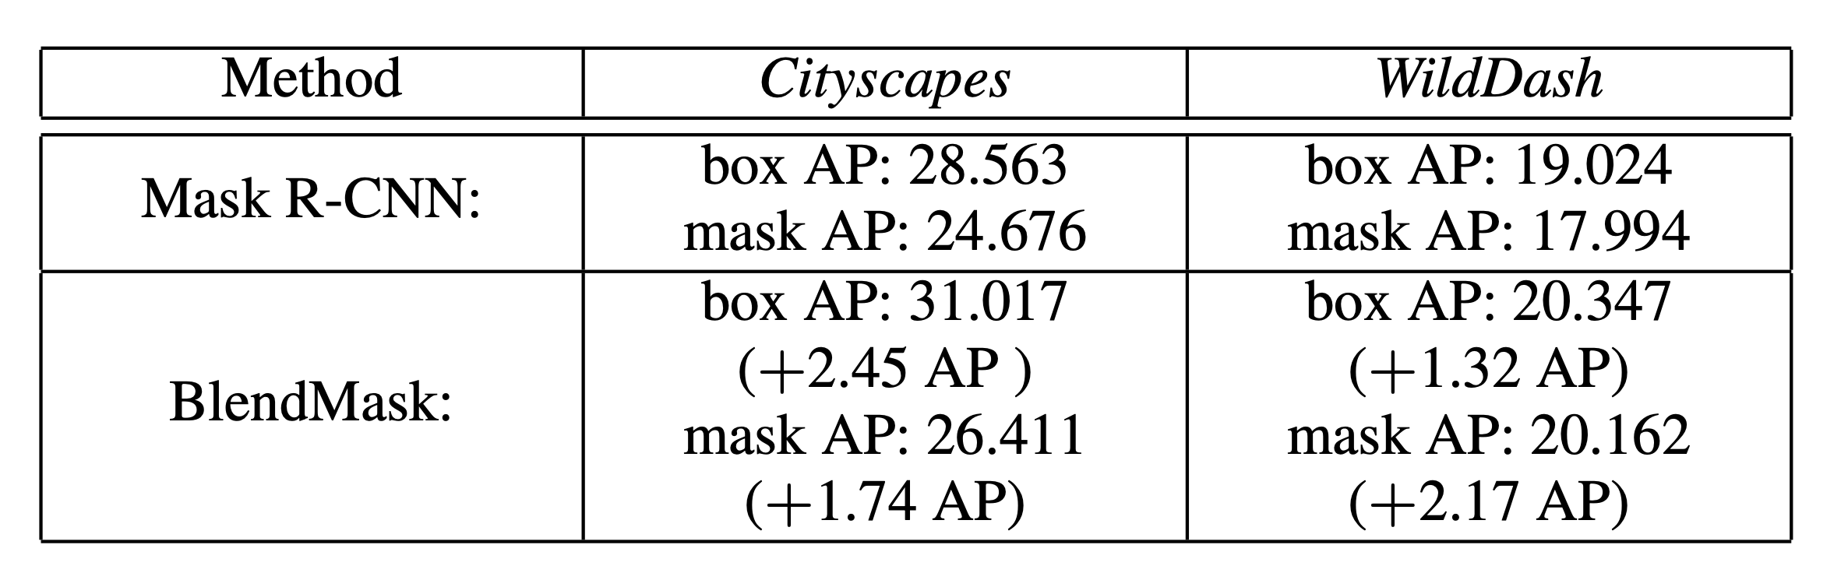
UNIVERSITY OF PADUA
UNIVERSITA’ DEGLI STUDI DI PADOVA
Vision and Cognitive Systems
Ideal Models

Slide 18
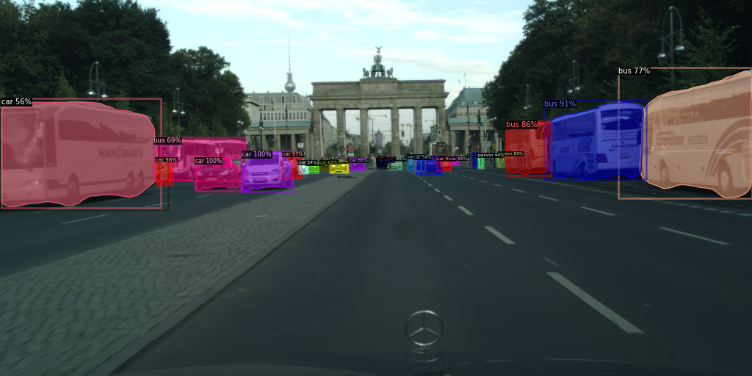
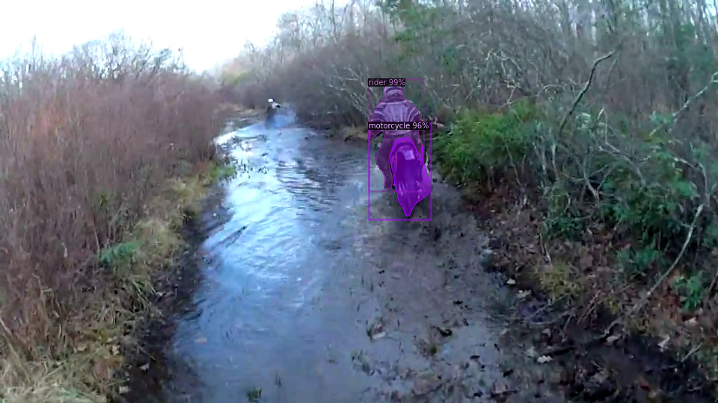
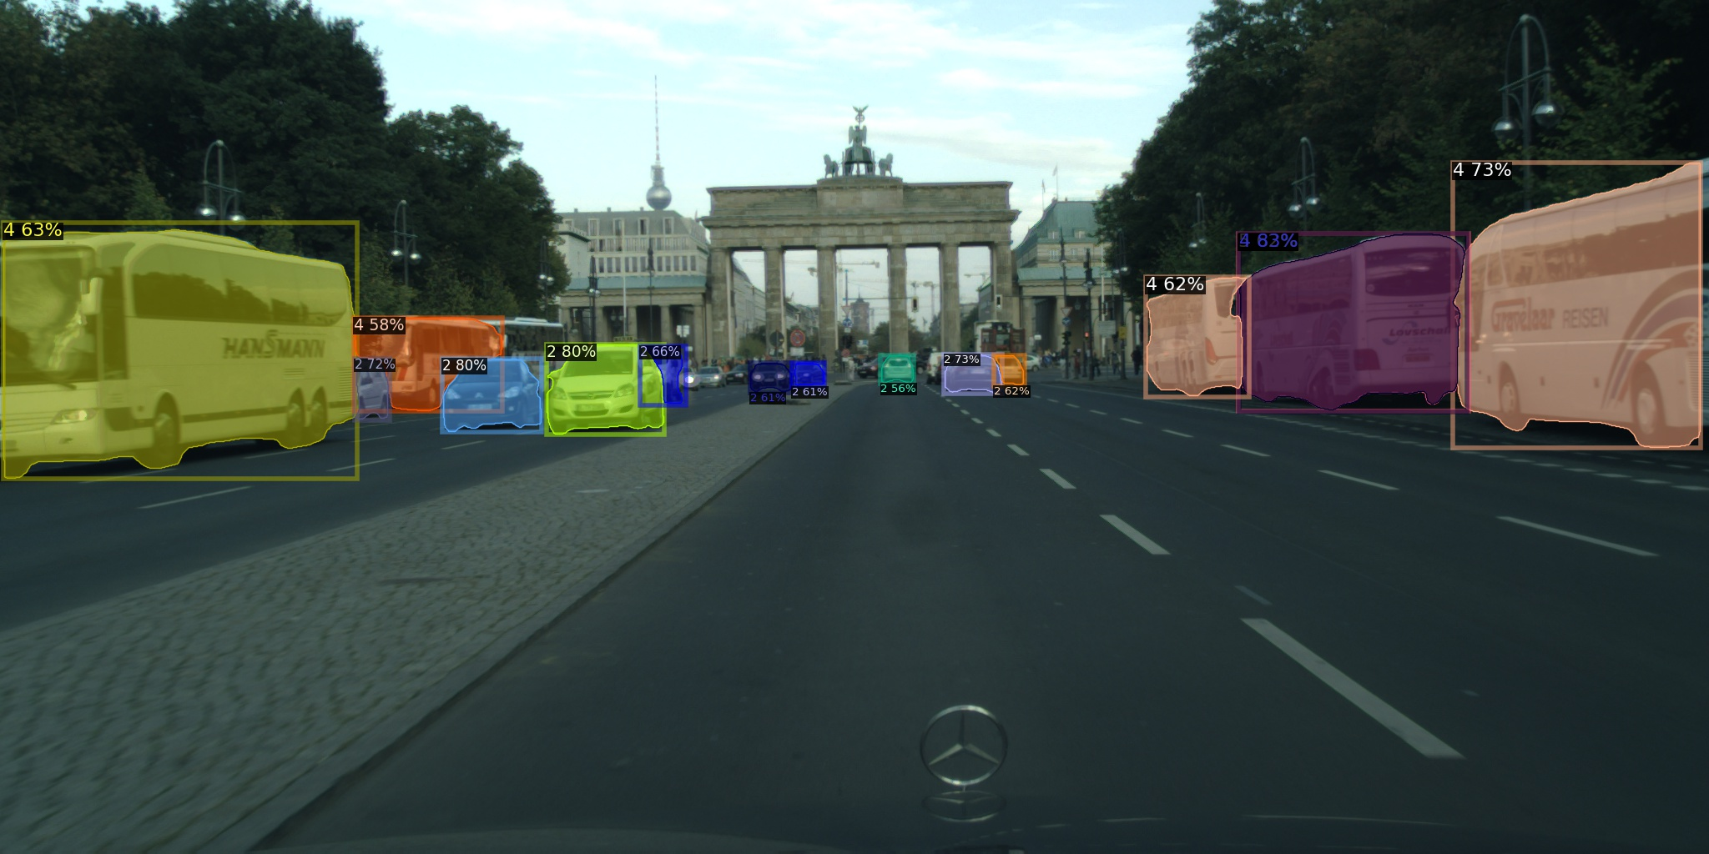

UNIVERSITY OF PADUA
UNIVERSITA’ DEGLI STUDI DI PADOVA
Vision and Cognitive Systems

Slide 19
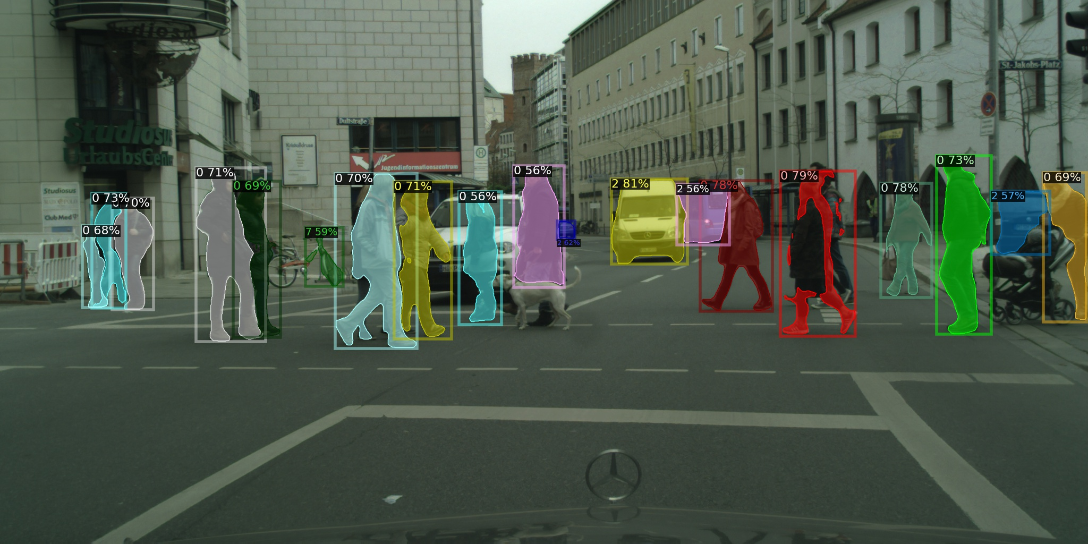
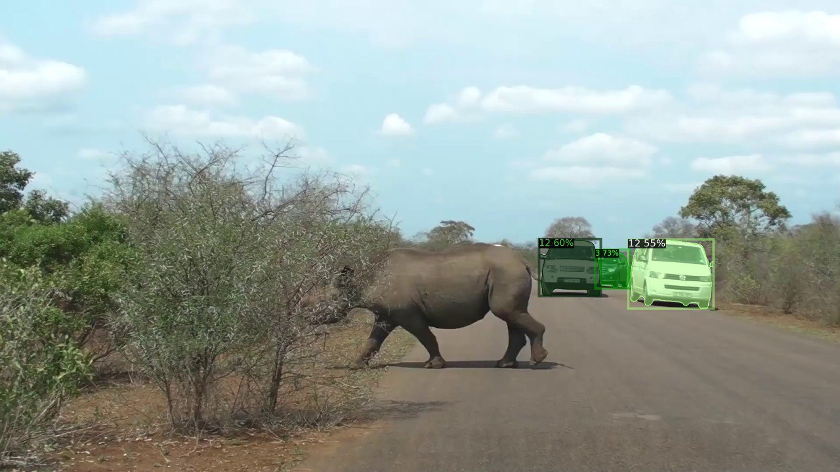
UNIVERSITY OF PADUA
UNIVERSITA’ DEGLI STUDI DI PADOVA
Vision and Cognitive Systems

Slide 20

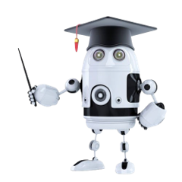
UNIVERSITY OF PADUA
UNIVERSITA’ DEGLI STUDI DI PADOVA
Vision and Cognitive Systems
Conclusion
- One-stage and anchor box-free techniques, suitably modified, perform better than box-based two-stage methods
- Caused by the hybridisation of top-down and bottom-up methods and the detection of unanchored objects
BLENDMASK wins in Average Precision and Time against Mask R-CNN
Is it possible to do better ?

Slide 21
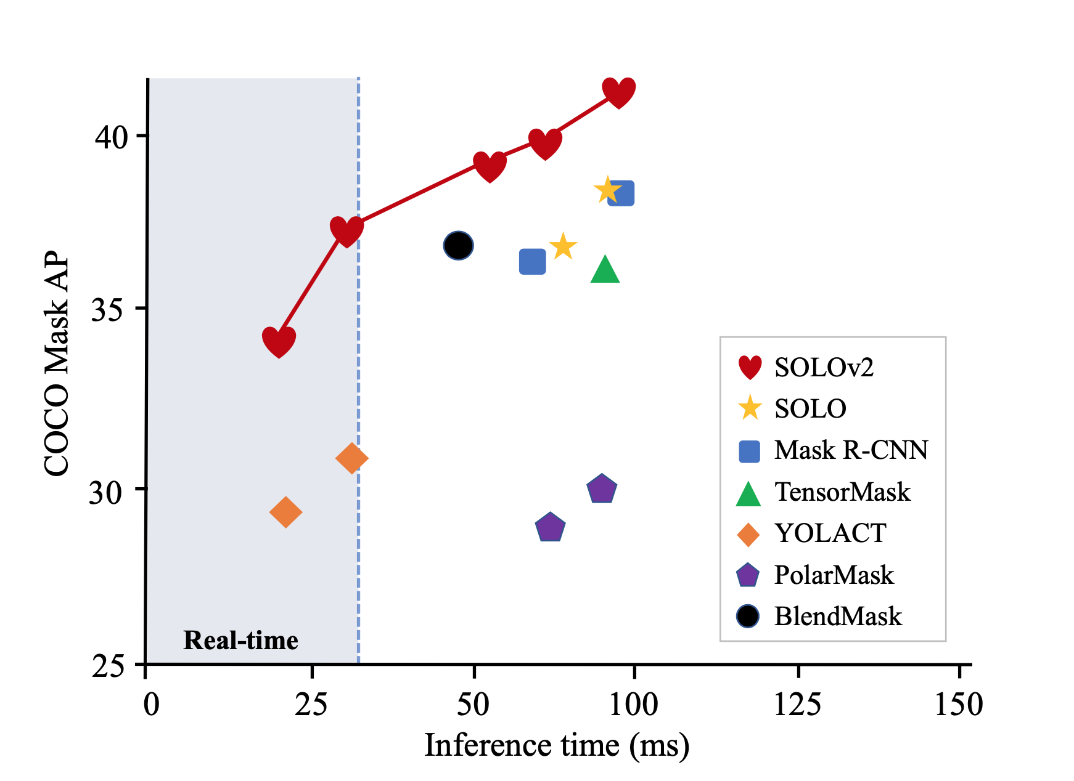
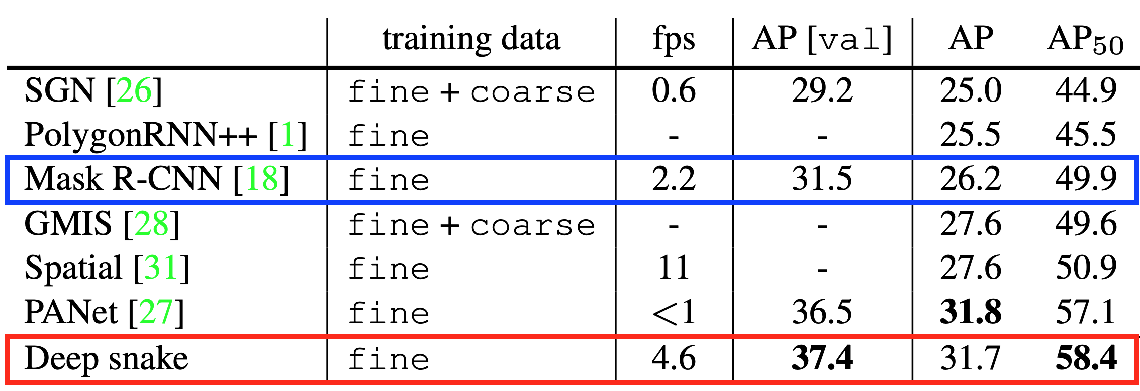
UNIVERSITY OF PADUA
UNIVERSITA’ DEGLI STUDI DI PADOVA
Vision and Cognitive Systems
- A box-free stage approach combined with matrix NMS, such as SOLOv2, is demonstrated to be very competitive against BlendMask
- Deep Snake outperforms Mask R-CNN in inference speed and AP

Slide 22
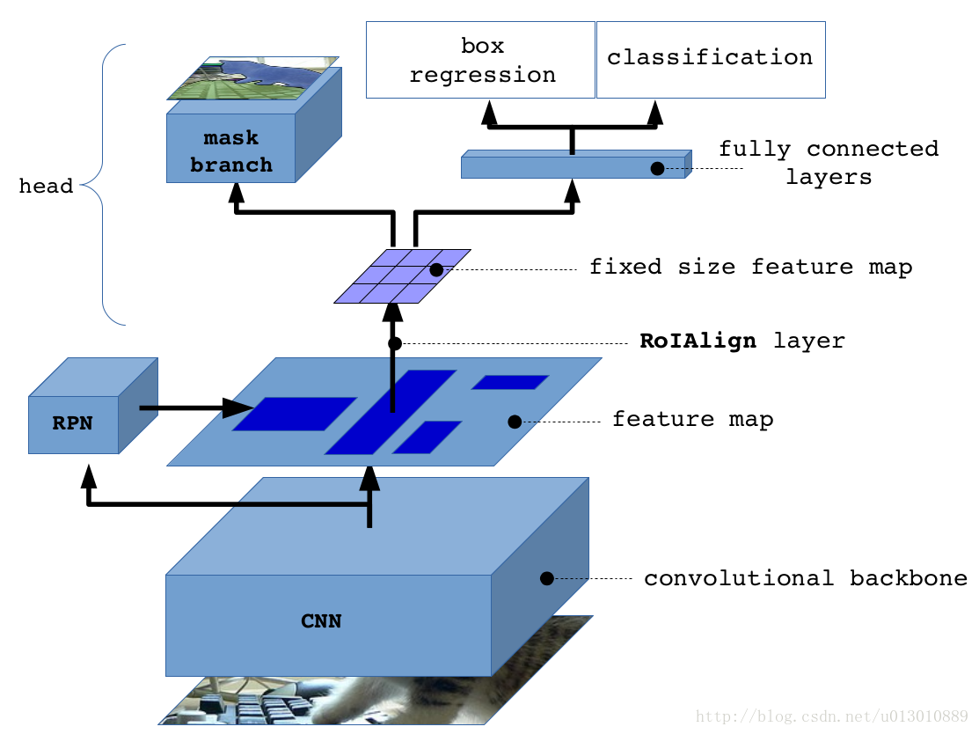
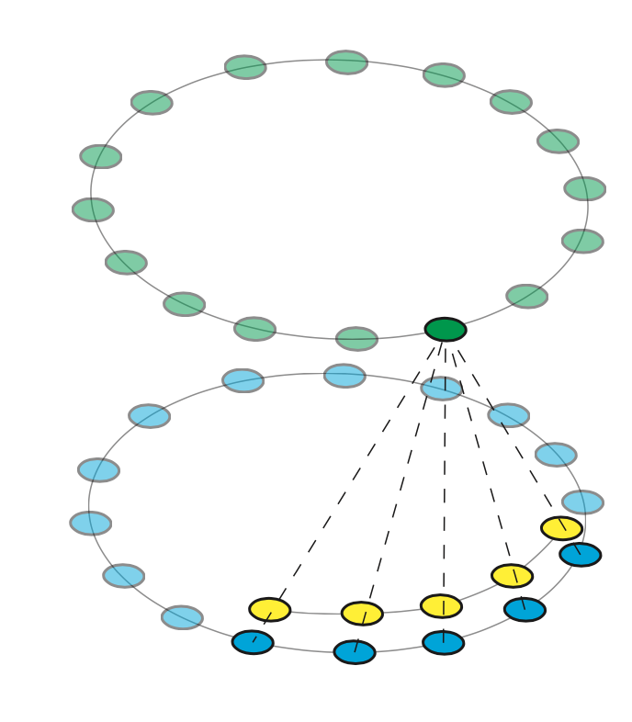
UNIVERSITY OF PADUA
UNIVERSITA’ DEGLI STUDI DI PADOVA
Vision and Cognitive Systems
Possible extensions
- Improve the performance of BlendMask by trying to use Deep Snake contour-based approach for detecting object bounding boxes of an image

Slide 23
UNIVERSITY OF PADUA
UNIVERSITA’ DEGLI STUDI DI PADOVA
Vision and Cognitive Systems
That’s all folks!
Francesco Bari
francesco.bari.2@studenti.unipd.it
Eleonora Signor
eleonora.signor@studenti.unipd.it

